Slide 1
Boomerang: Healthcare Companion App
Group Members: Jemma, Yvonne, Nicole

Slide 2
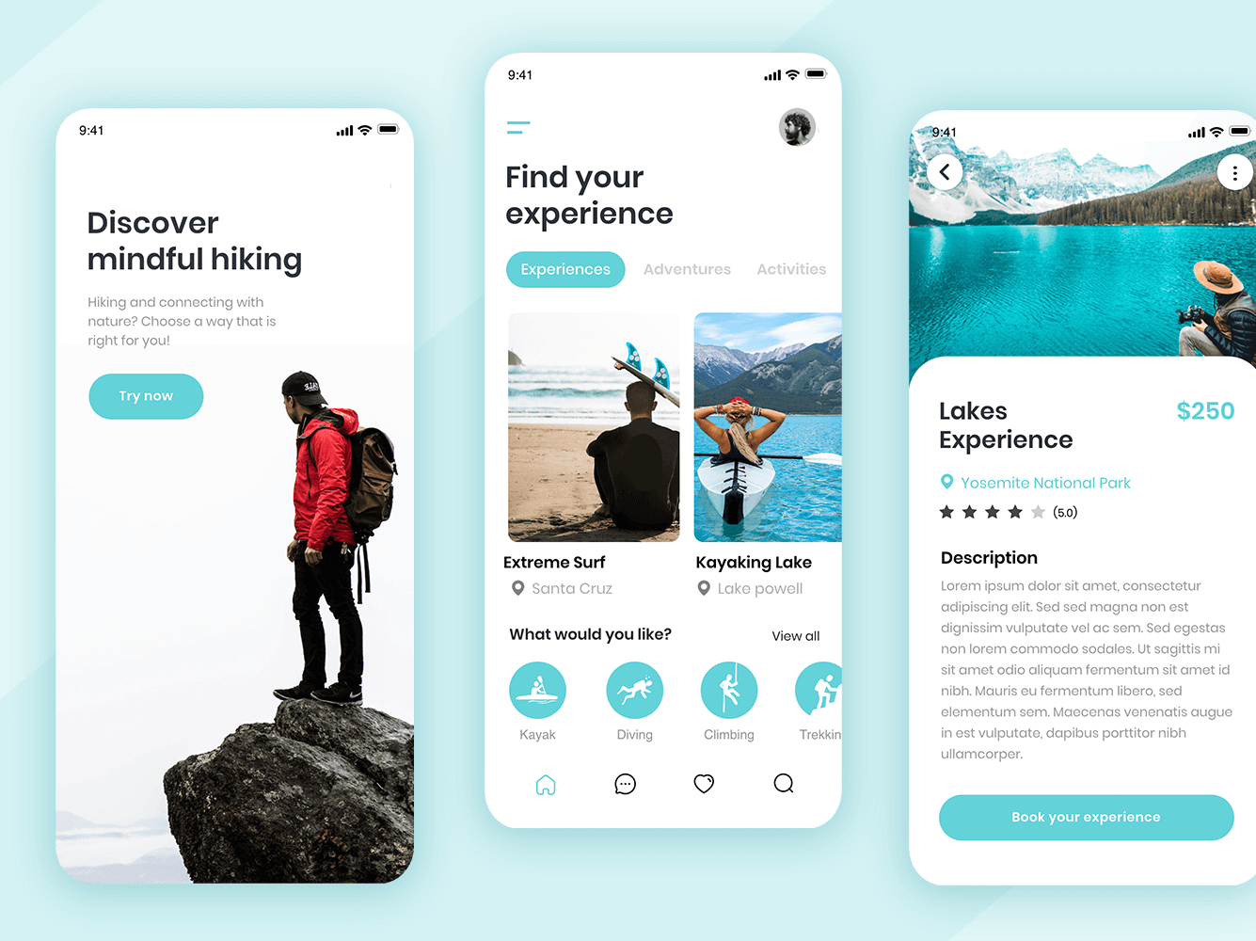

Slide 3
Ideas ranked against criteria
Idea | Accessibility | Usefulness | Innovation | Simplicity | Rank
Medicine reminders app |  |  |  |  | 1
Health metrics tracker |  |  |  |  | 2
Curated medical knowledge app |  |  |  |  | 3
Emergency alert system | Out of scope |  |  |  | 4

Slide 4

Functional Requirements
Respond
- Respond to health-related queries using data provided by internal professionals
Provide
- Provide personalised goals and reminders
Send
- Send medicine reminder notifications
Track
- Track medicine usage and history
Record and display
- Record and display health metrics
Suggest
- Suggest lifestyle tips
Provide
- Provide access to curated health database

Slide 5
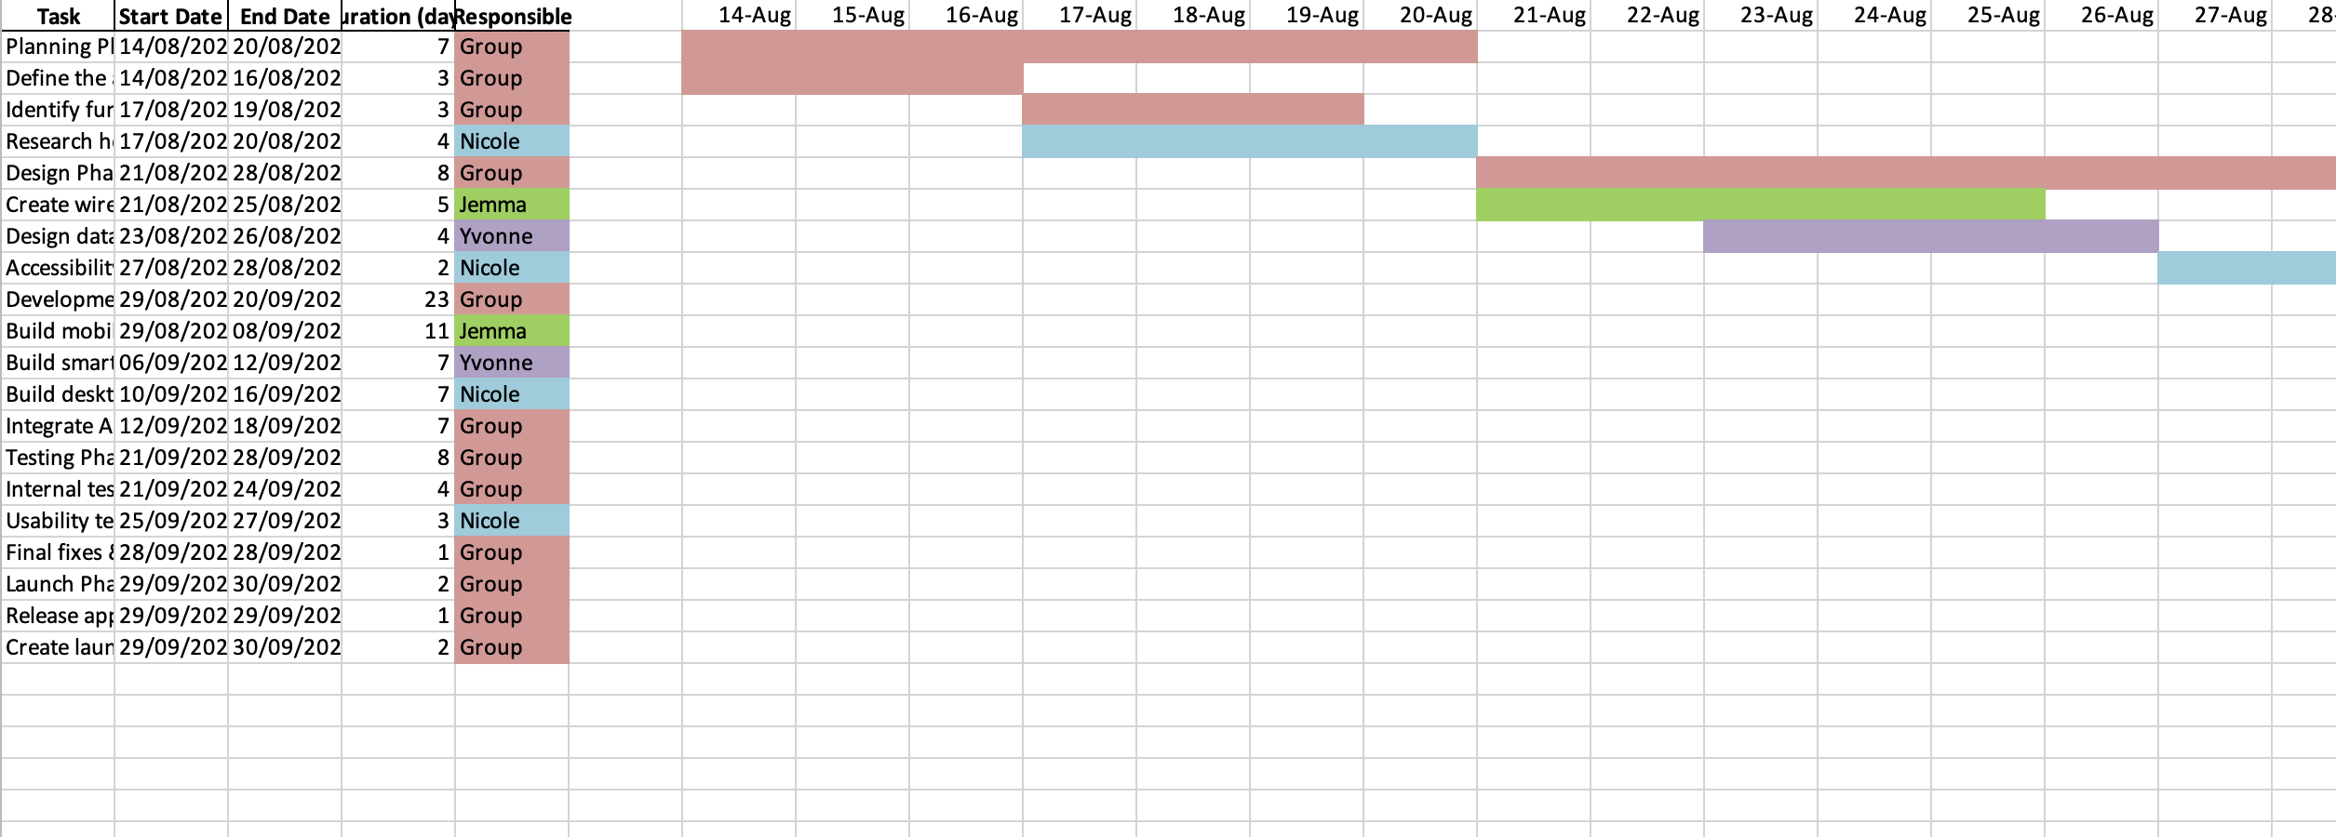
Gant chart

Slide 6

Non-Functional Requirements
Reliable: accurate and consistent
User-Friendly: large text, zoom features
Engaging: rewards, progress tracking
Secure: encryption, secure login
Accessible: works on varied devices

Slide 7
Platforms
- Smartphones (Android, iOS)
- Smartwatches (Apple Watch, Wear OS)
- Desktop/Web App (Windows, macOS, Web Browser)

Slide 8
Key Functions (Scope)
Monitor and record health metrics
Provide medicine schedules and reminders
Suggest lifestyle tips
Give health check-up prompts
Personalised suggestions
Access to verified health database

Slide 9
Out of Scope
- Real-time emergency monitoring (e.g., fall detection)
- Integration with hospitals or GP systems in early versions

Slide 10

Target Audience
Primary: Elderly individuals (ages 60+)
Secondary: Caregivers or family members managing elderly health

Slide 11

Resources Required
- Development team (mobile, web, smartwatch)
- APP designer (accessibility focus)
- Healthcare professionals for data
- Secure database and hosting
- Testing devices (phones, watches, desktops)

Slide 12
Competitors
Epocrates: medical reference app for patient care
Medscape: medical info & education for professionals
UpToDate: comprehensive medical knowledge tool

Slide 13
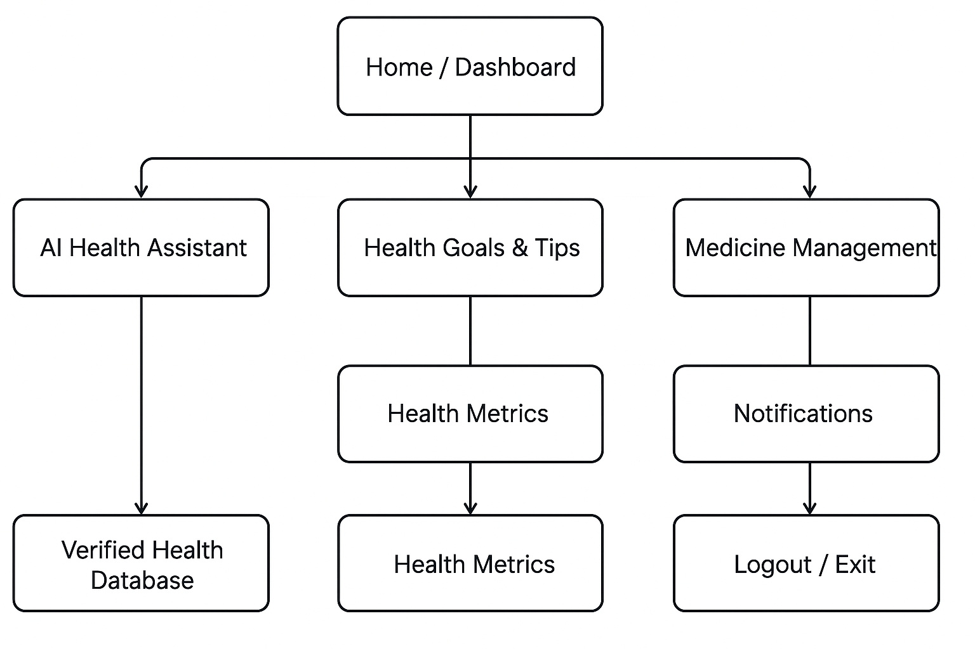
Site map

Slide 14
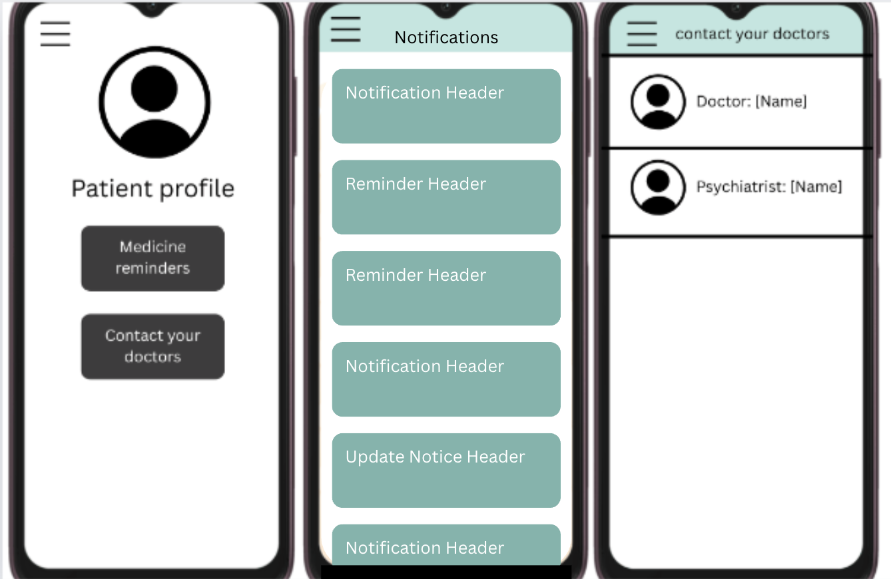
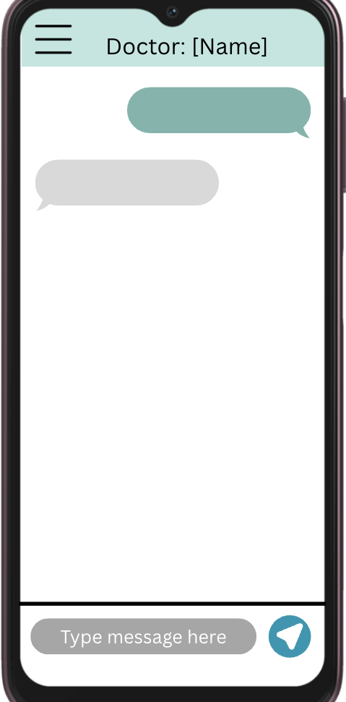
Mock-up designs

Slide 15
Pseudocode
BEGIN
DISPLAY "Welcome to Boomerang"
LOGIN or REGISTER user
WHILE user is logged in DO
DISPLAY menu options
GET user choice
IF choice = "Ask question" THEN
DISPLAY AI health response
ELSE IF choice = "Set reminder" THEN
SAVE medicine reminder
ELSE IF choice = "Record health data" THEN
STORE health metrics
ELSE IF choice = "View tips" THEN
SHOW lifestyle suggestions
ELSE IF choice = "Access info" THEN
DISPLAY verified health articles
ELSE IF choice = "Logout" THEN
EXIT loop
END IF
END WHILE
DISPLAY "Goodbye!"
END

Slide 16
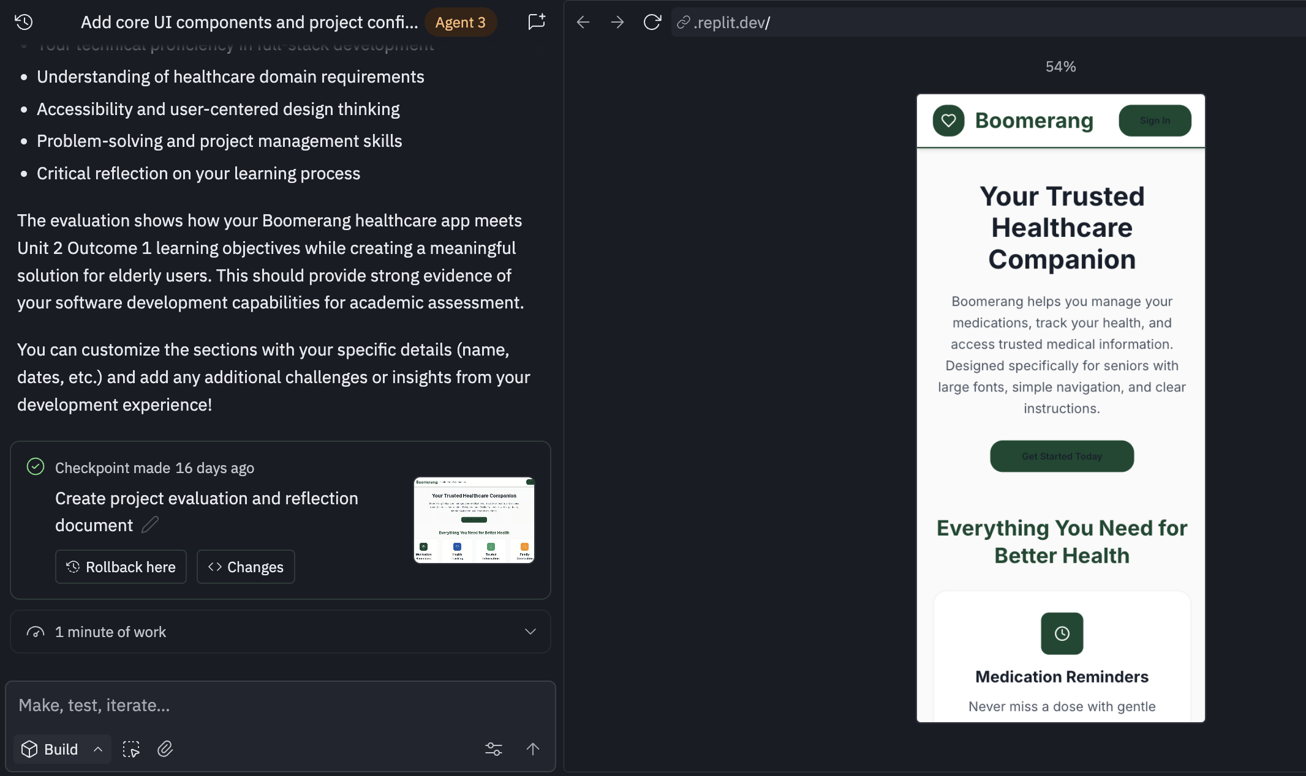
AI -model of the app

